Slide 1
Introducing the MCRLdata Sandbox!
Peter Regier
Notes:
Image: Sequim Bay

Slide 2
Outline
Background
What is the MCRLdata sandbox?
Current capabilities
Open forum – what do YOU want?
Useful links
MCRLdata - https://mcrldata.pnnl.gov/
MCRLdata sandbox - https://github.com/MCRLdata-Sandbox
These slides

Slide 3

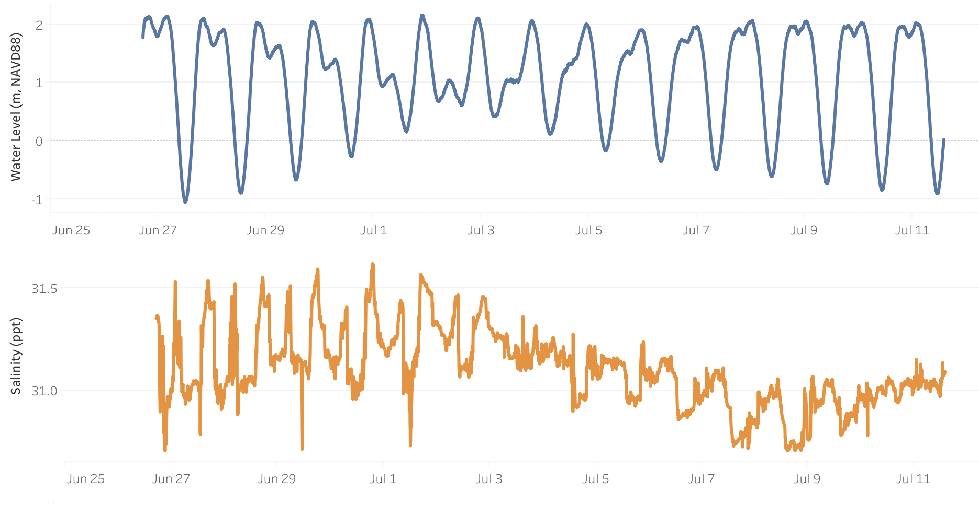
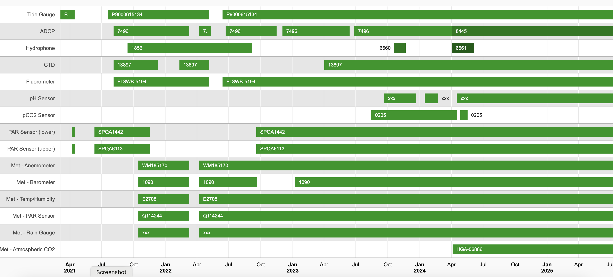
The MCRLdata pipeline
“monitoring and numerical modeling efforts to support coastal research projects, guide operations, and characterize long-term environmental trends in Sequim Bay”
Some key functions
Connects sensors via IOT to the cloud
Hosts datasets and runs initial QC
Plots data interactively in real-time
Detailed sensor information
MCRLdata is amazing, and does so much behind the scenes
https://mcrldata.pnnl.gov/

Slide 4
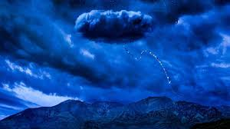
Barriers to increased MCRLdata use for all
Data stored on AWS - require credentialing, data requests
Many data types – need custom QC, knowledge of data
Where to put data from non-IOT sensors / relevant lab samples?
Best for coders, some barrier to entry for non-coders
MCRLdata is amazing, let’s enhance / expand and lower barriers to entry

Slide 5

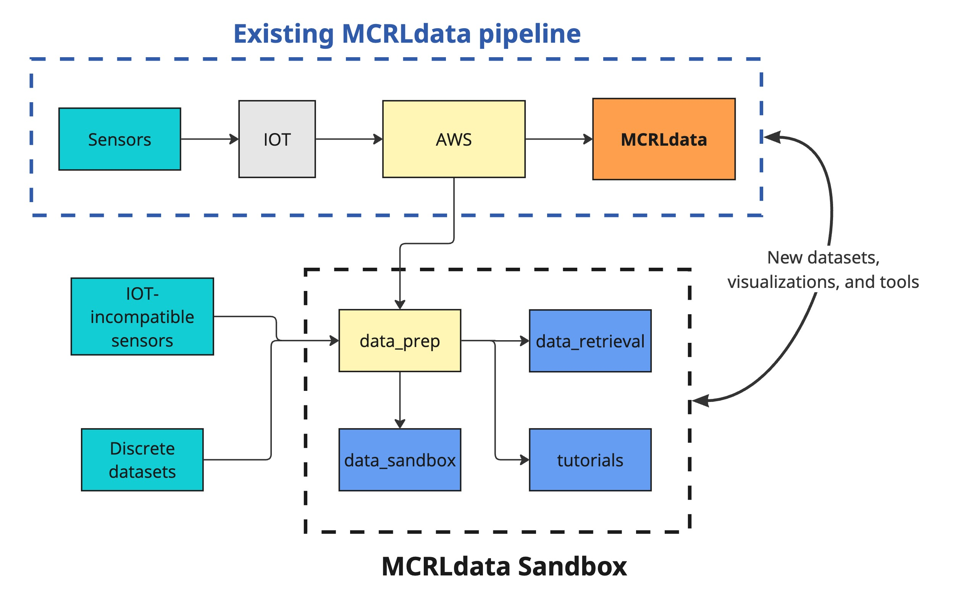
The MCRLdata sandbox
🤝
A set of scripts and tools to enhance and expand MCRLdata capabilities
New ways to access to data
A home for non-IOT data
Additional QC
Purpose-built visualizations
Tutorials
Play along at home! https://github.com/MCRLdata-Sandbox

Slide 6
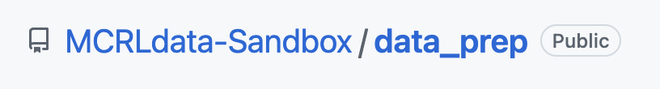
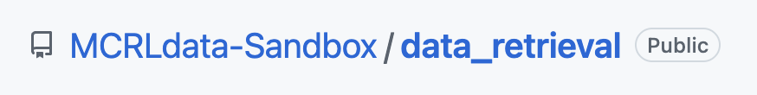

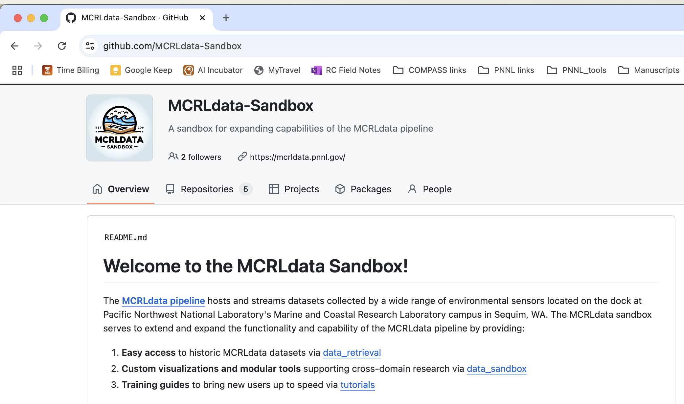
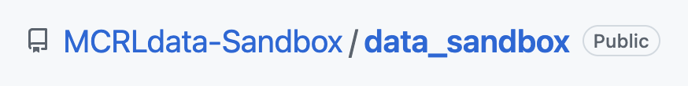
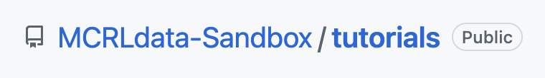
But…. what is it?
🥩
QC datasets, data source for other repos
MCRLdata sandbox = Github organization
An organization contains related repositories
Code is publicly, freely available
Data are publicly, freely available
🛠️
Provides various methods for accessing MCRLdata datasets
⭐️
Provides tools and visualizations
📚
Resources for those new to coding: using Github, accessing data, intros to coding…

Slide 7


Overview – current contents
🥩
⭐️
L1-cleaned datasets (remove flags, potential additional QC) – analysis-ready*
Tide gauge water levels
ADCP velocities
Met station Air temps/windspeeds
CTD water temps/salinity
TA/DIC (Cross LDRD)
Many plots
Seasonal ops-focused summary
Natural variability envelopes
Initial carbonate chemistry
📚
🛠️
Available tutorials
Setting up R/Rstudio
Intro to coding in R
Intro to L1 data
Intro to ML (Random Forests)
Code for access S3 via SSO in R – real-time on-demand data access**
* Only YOU know what data quality your application needs!
** Requires coding skills, AWS access, setting up CLI and regular SSO authorization

Slide 8
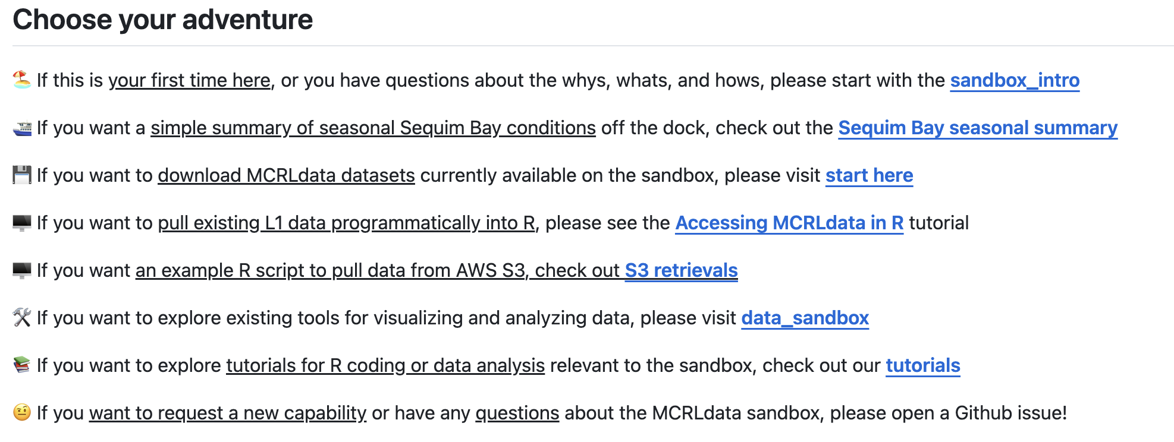
Quick start guide
Links to guide folks through organization based on FAQs
https://github.com/MCRLdata-Sandbox

Slide 9
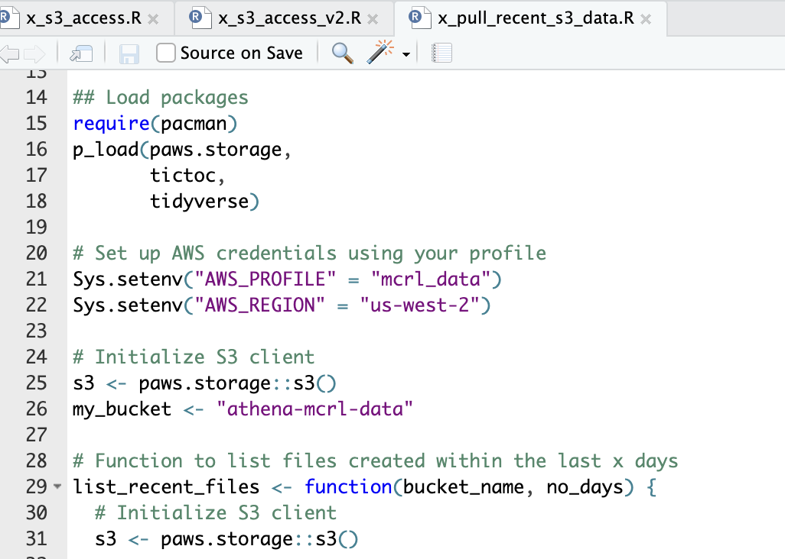
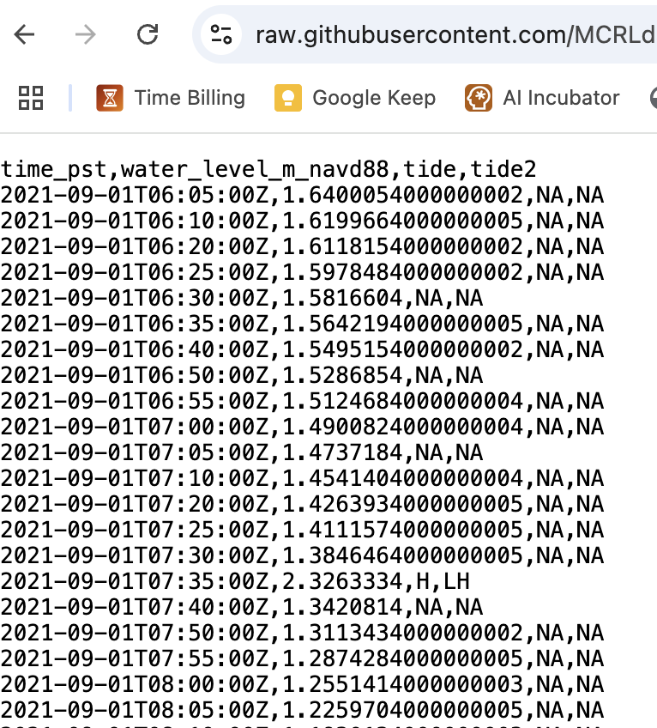
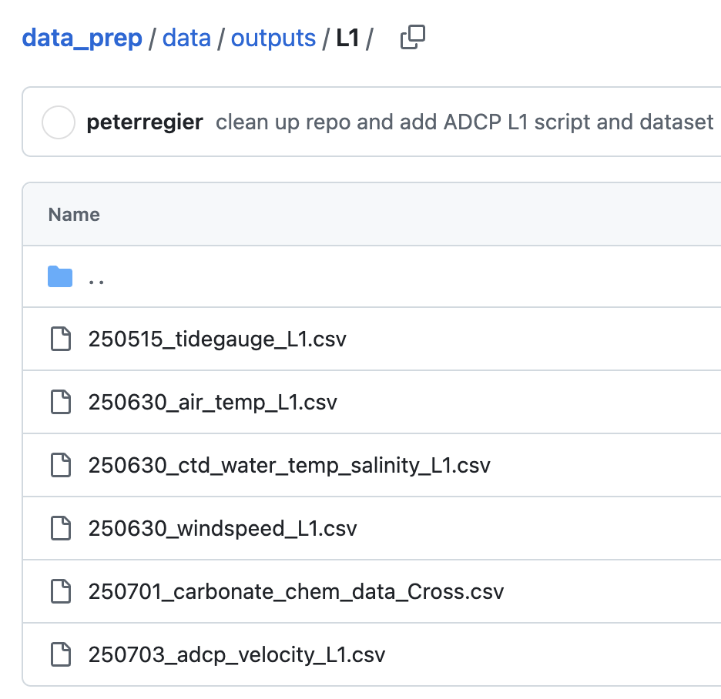
New ways to access data
Pull via CLI into R - raw data
Pull data into R
Download data files
Any data, any time!
Data are raw w flags
Requires AWS account
Requires setting up CLI/SSO
Costs $ per pull
Any L1 data via code!
Programmatic
Only data already L1 QC’ed
Step-by-step tutorial
Any L1 data, and easy!
Not programmatic (manual)
No coding required
Only data already L1 QC’ed

Slide 10
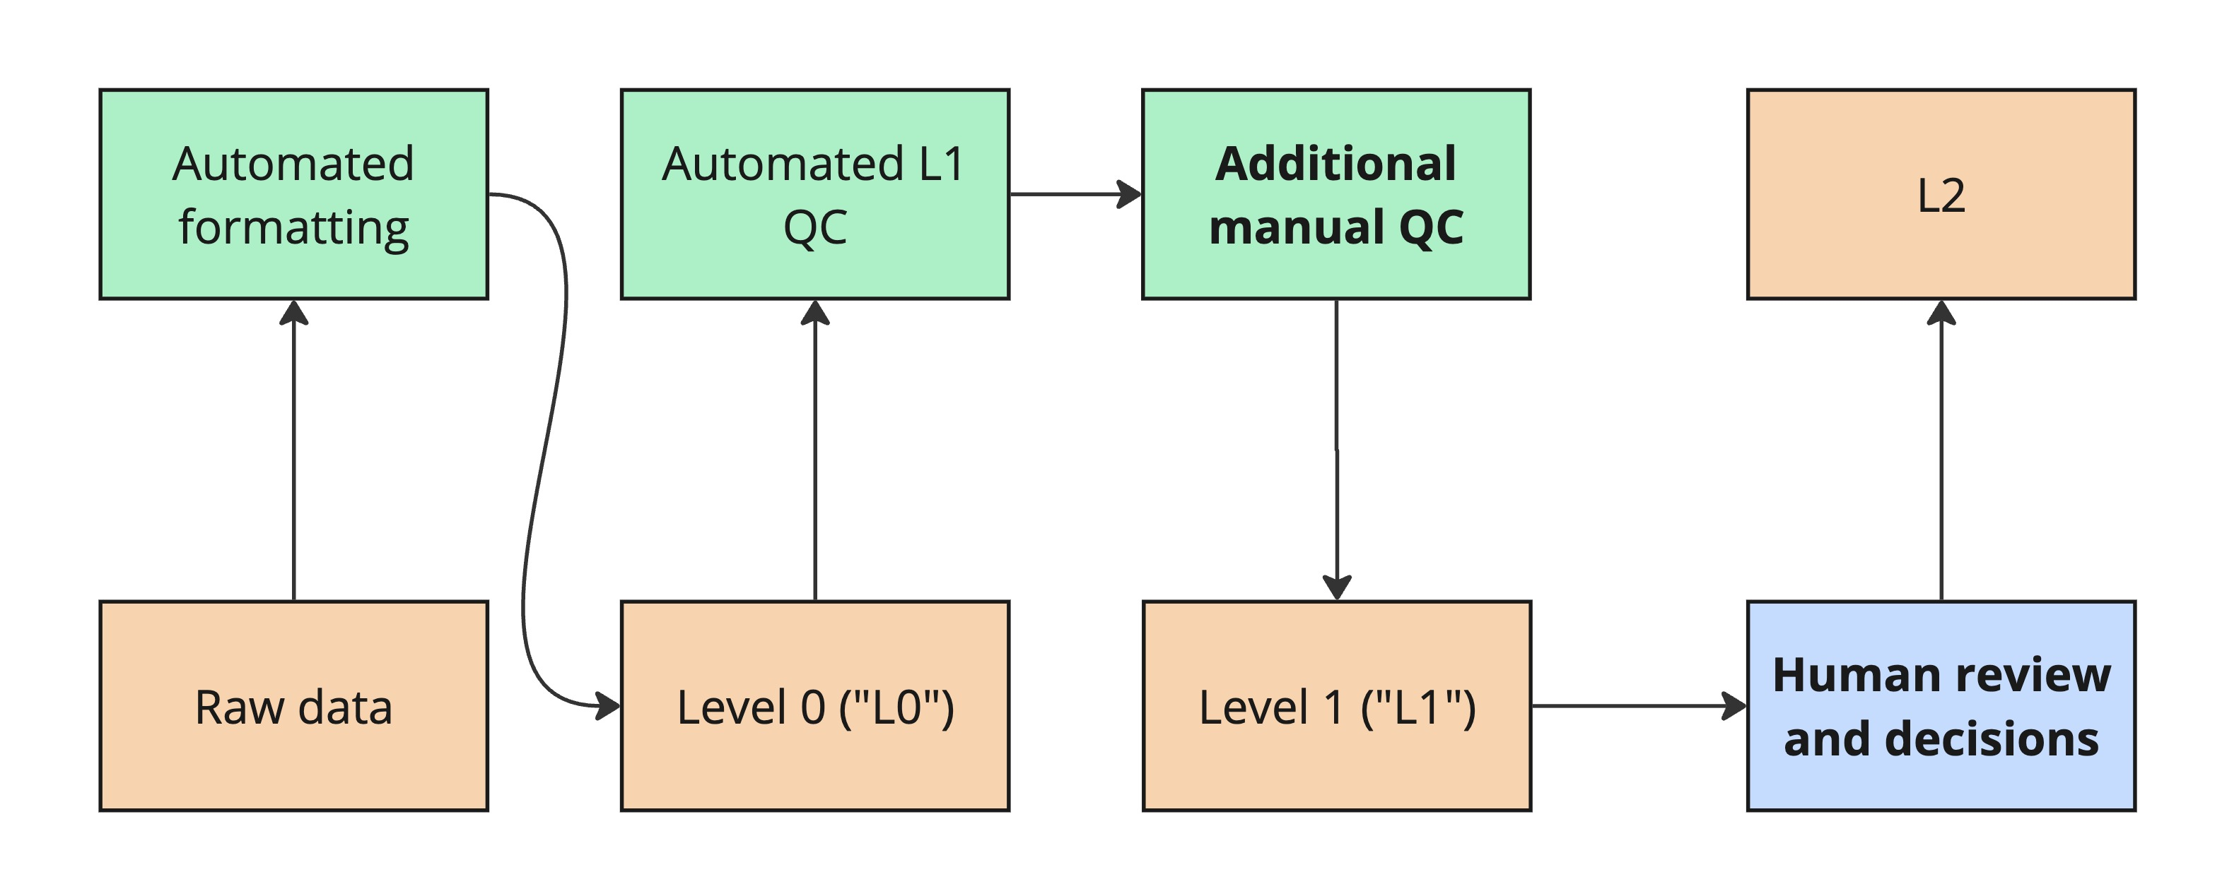
Quality control – some definitions
MCRLdata pipeline
Sandbox
Outside (current) scope
Sandbox provides L1 for select datasets – not flawless data!!

Slide 11
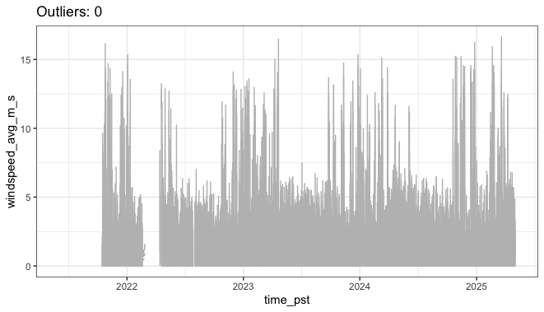
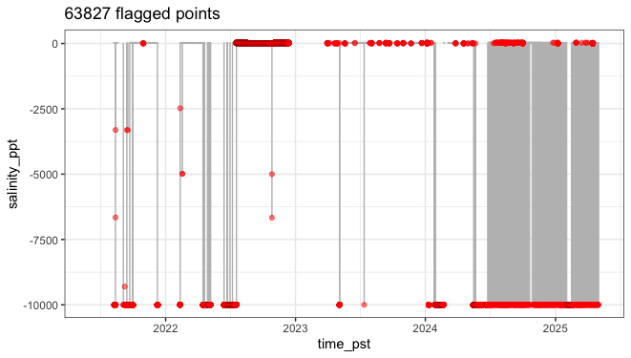
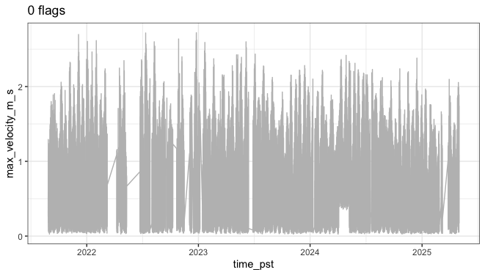
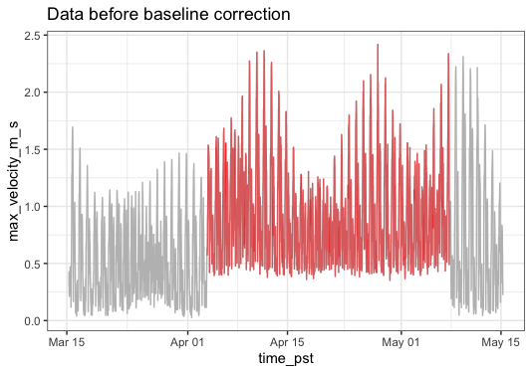
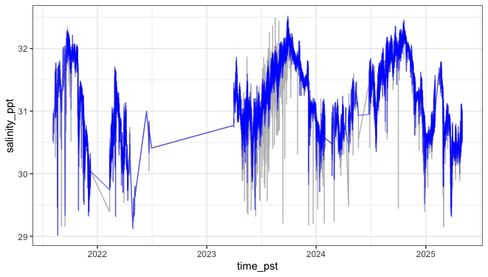
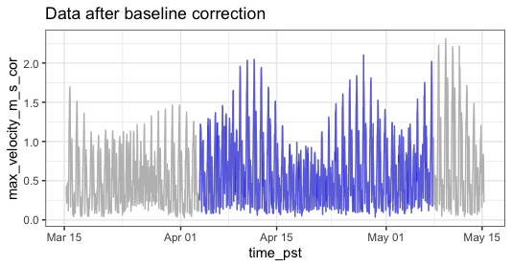
QC examples – eyeballs required
Windspeed: 0 flags, looks clean
Salinity: flags and spikes
ADCP: no flags, baseline issues
Despiking
Isolate event
Correct

Slide 12
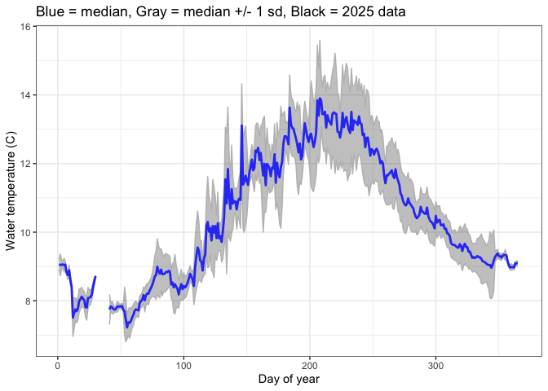
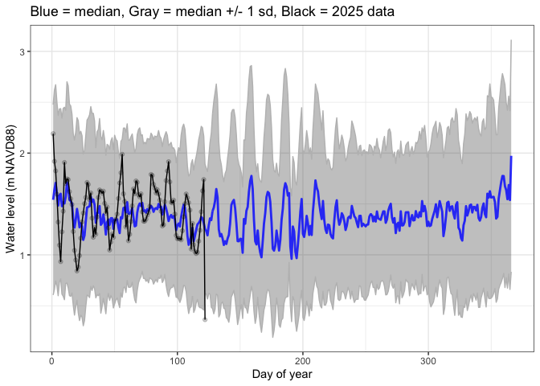
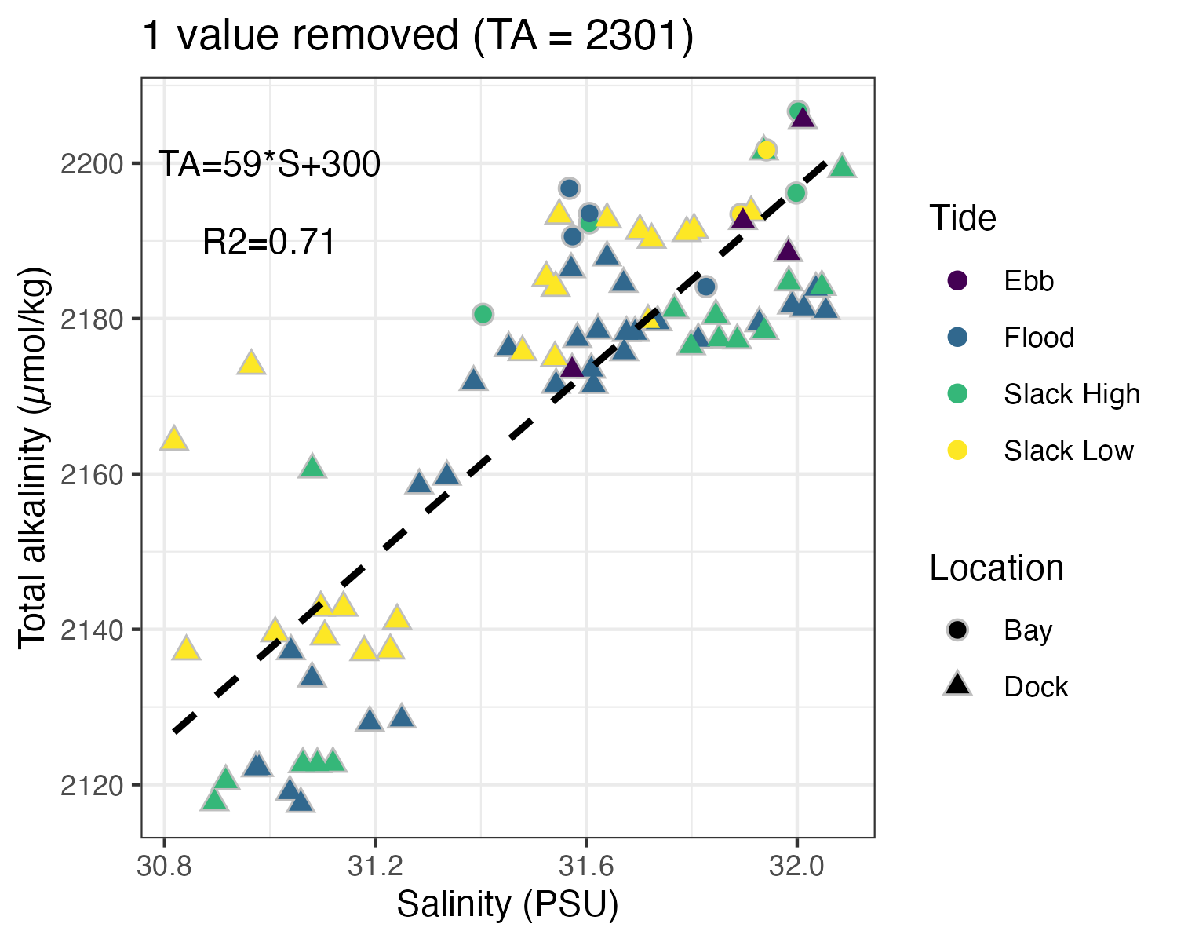
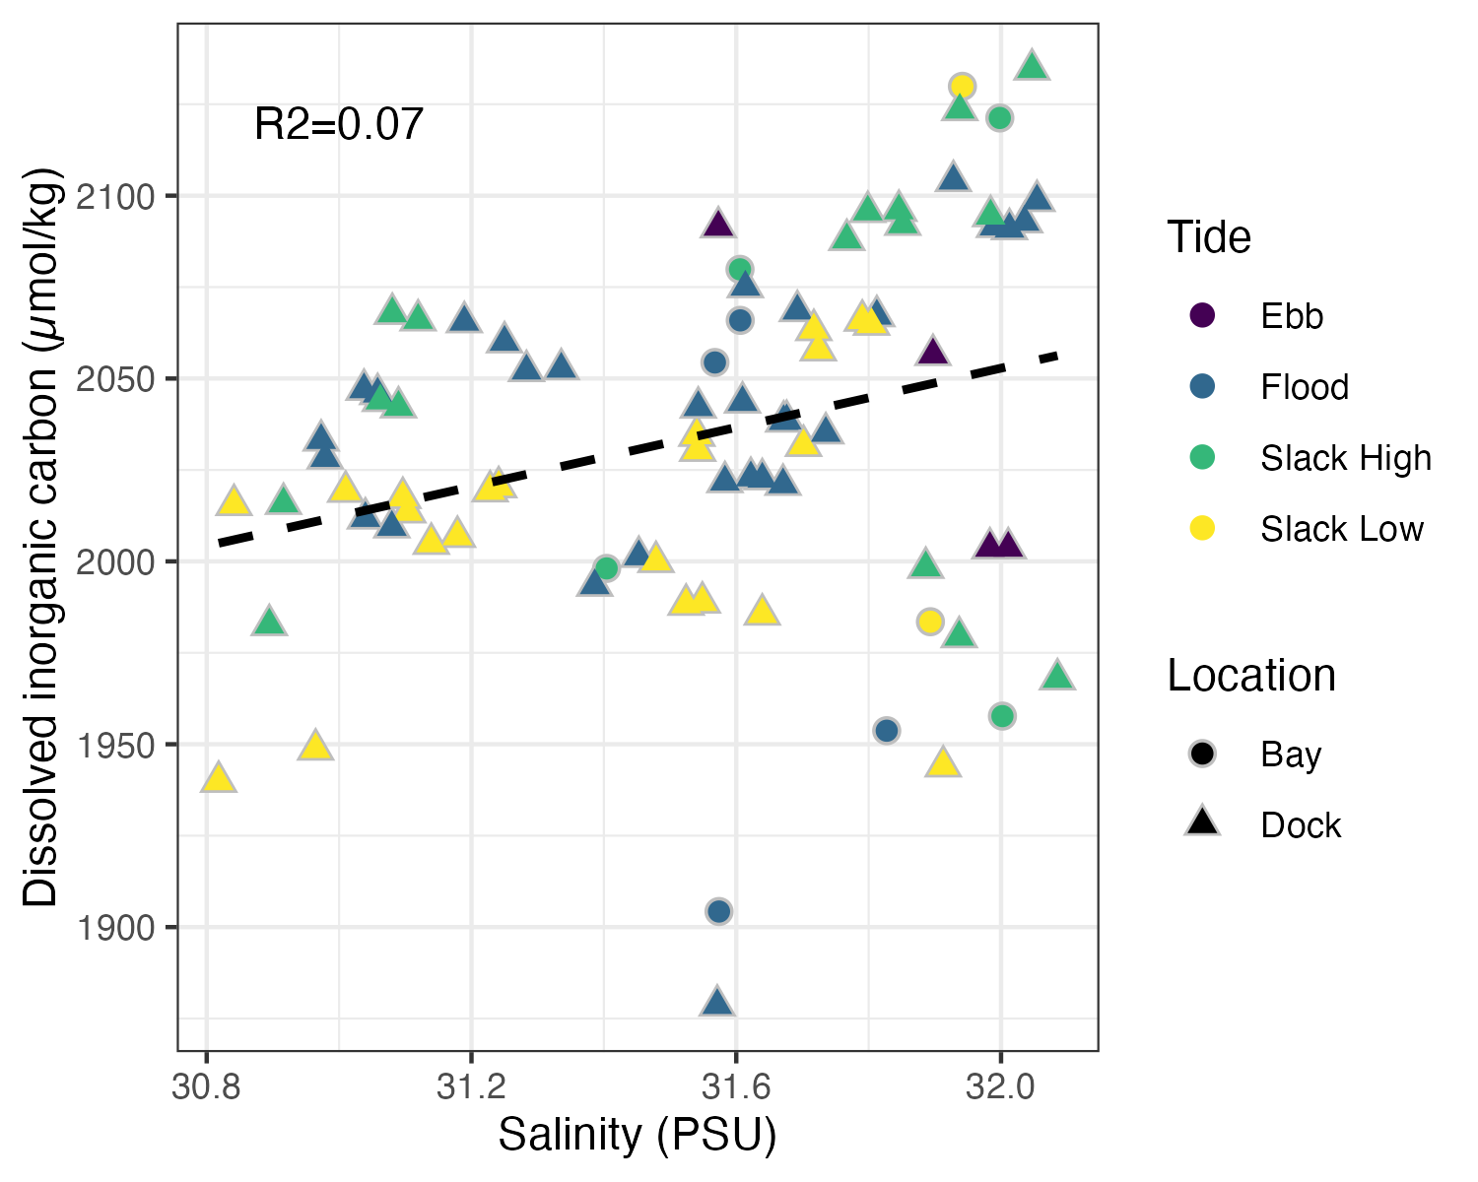
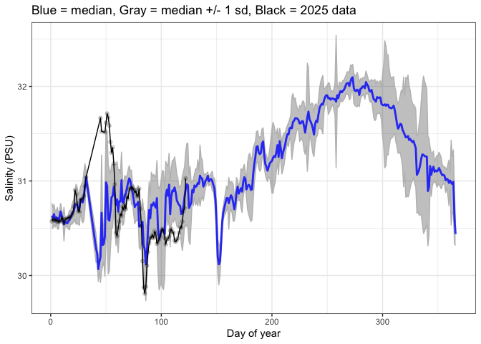
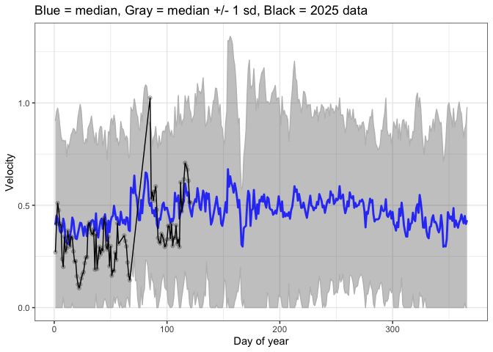
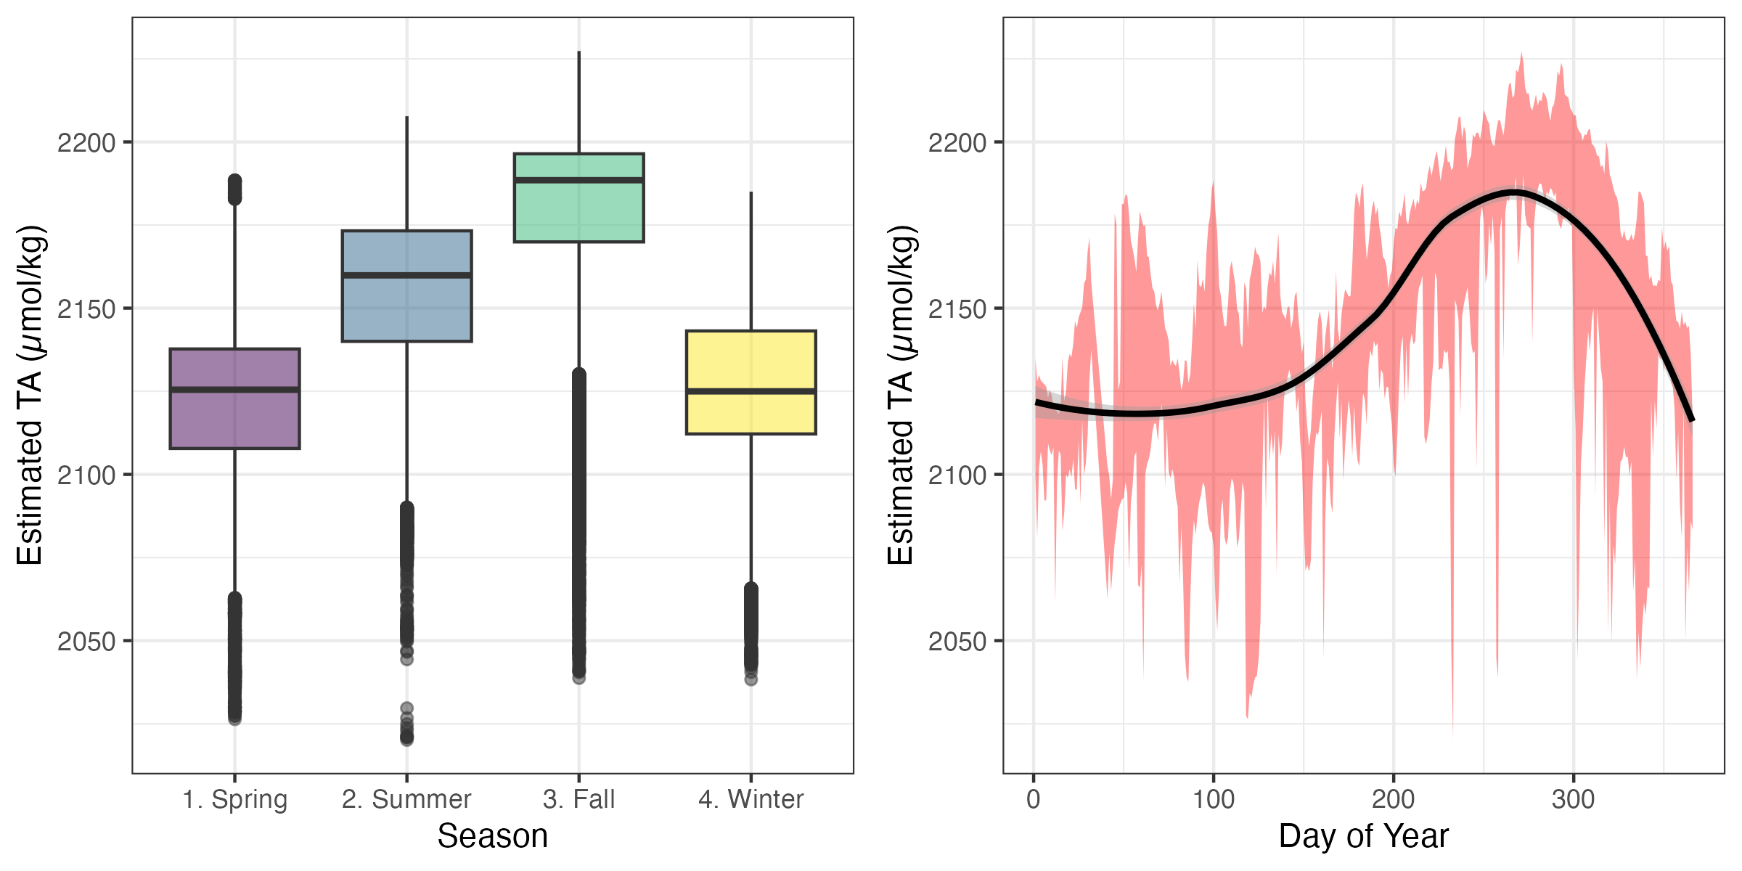
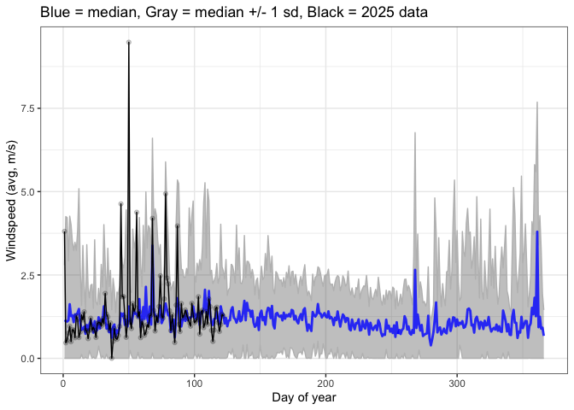
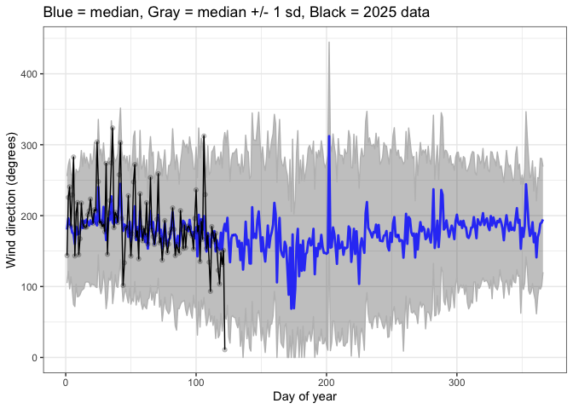
Example – natural variability
MCRLdata sensors
Grab samples (thanks Jess/Tristen!)

Slide 13
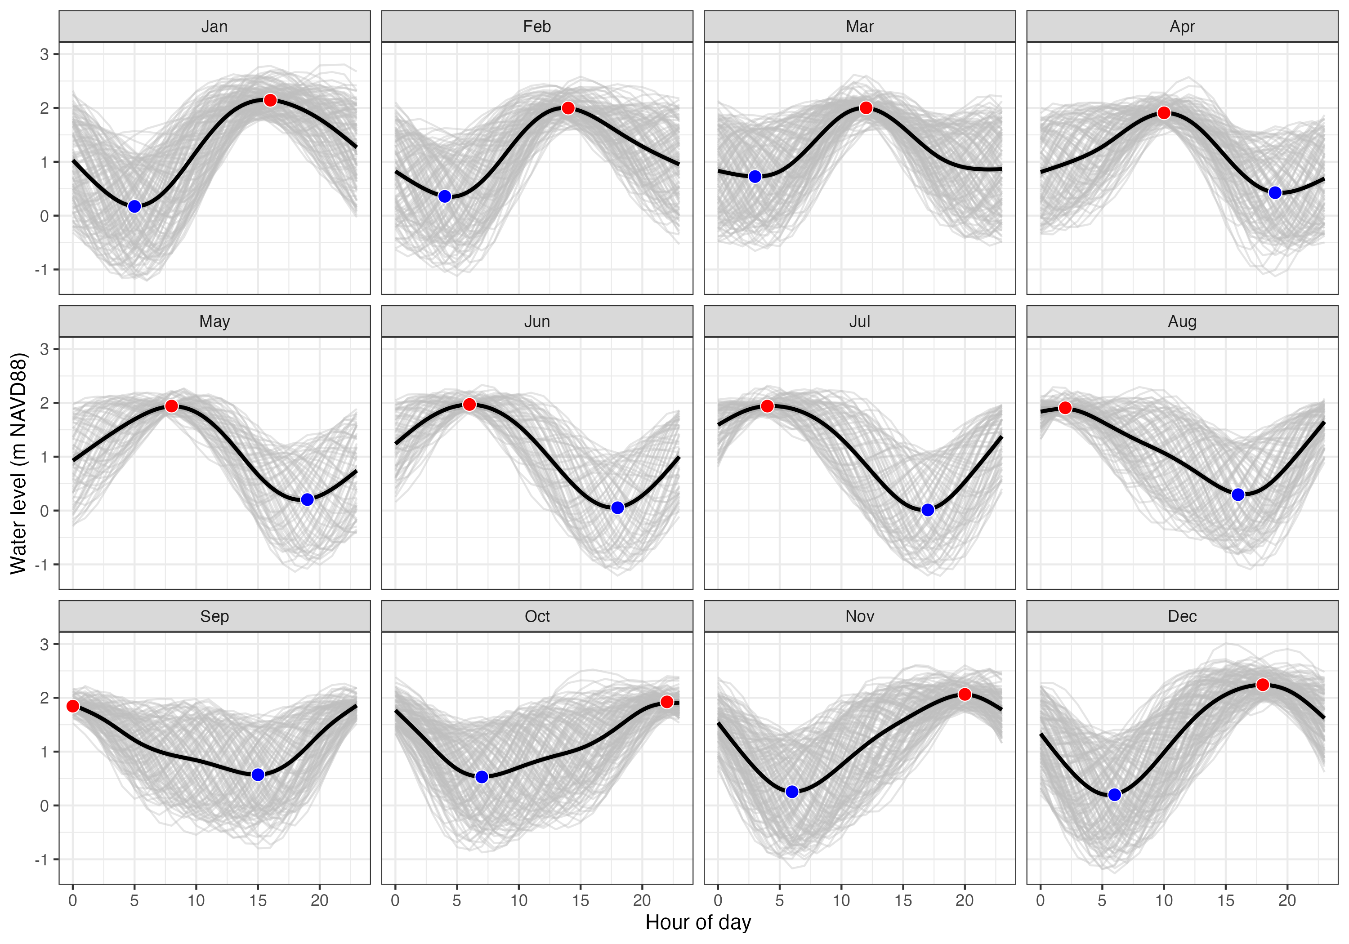
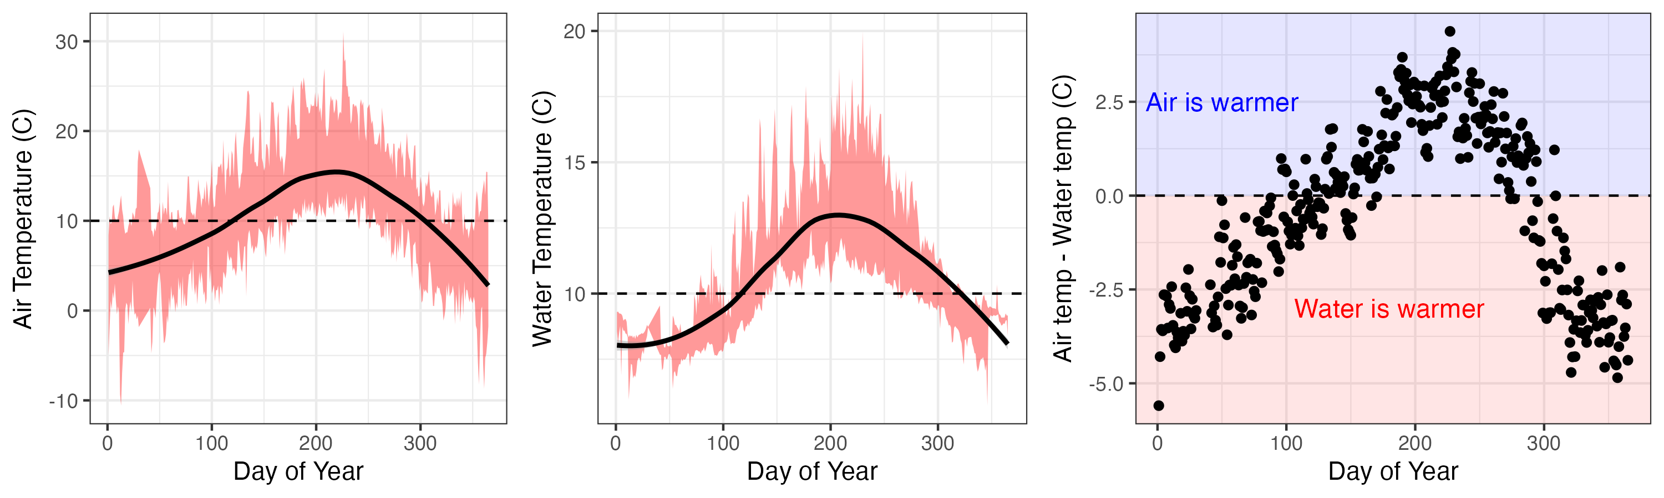
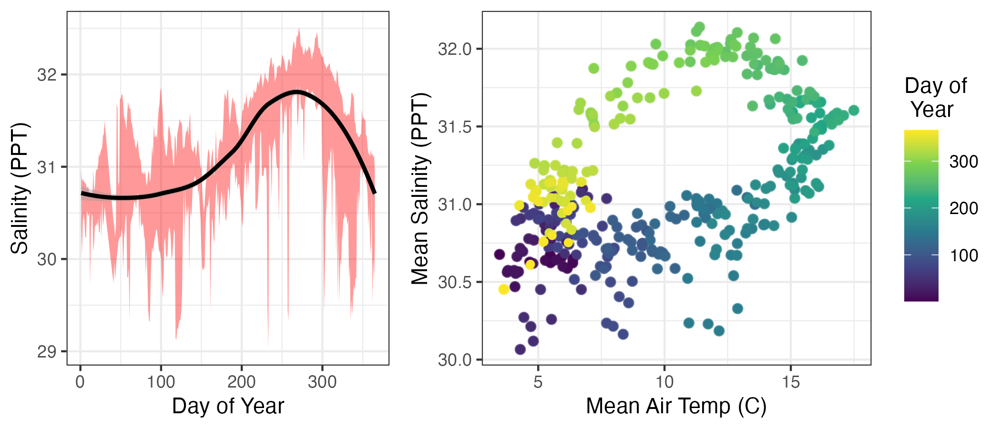
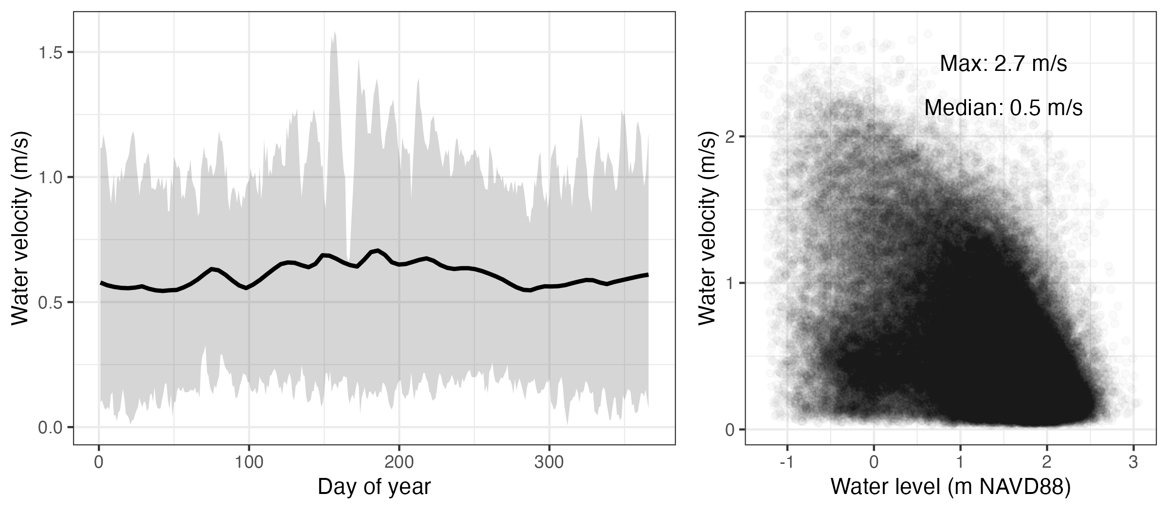
Example – Context for Sequim Bay ops
Air and water temperatures
Tidal water levels
Salinity patterns and relationships
Water velocities
https://github.com/MCRLdata-Sandbox/data_sandbox/blob/main/scripts/3_sequim_bay_seasonality.md

Slide 14
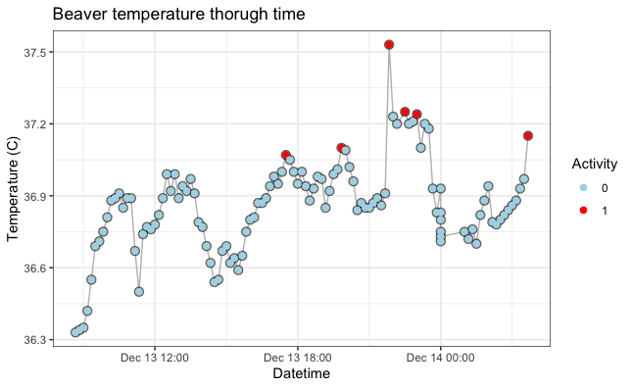
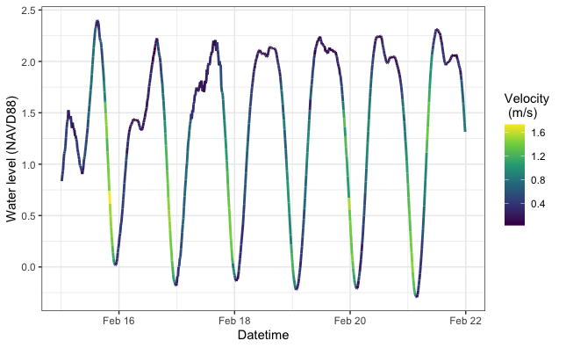
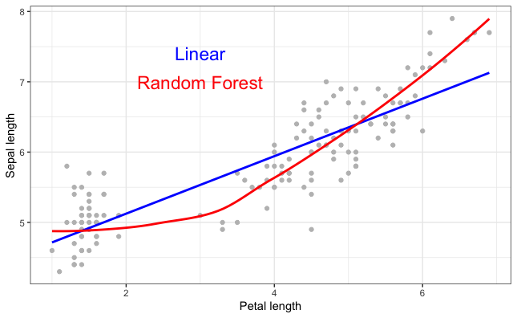
Examples – Tutorials (focused on R)
Goal - Starting from zero, learn at your own pace to use MCRLdata more
R basics
Installing packages
Working with data
Making plots
L1 data basics
Pulling data from sandbox
Working with it
Making plots
Machine learning basics
The whats and whys
Prepping a model
Interpreting output
https://github.com/MCRLdata-Sandbox/tutorials

Slide 15
Vision – a free, permanent, growing resource
Tools/data are permanent – no $ required to maintain
Starting point for new folks / those interested in getting closer to data/code
New tools can be built by all, shared with all

Slide 16
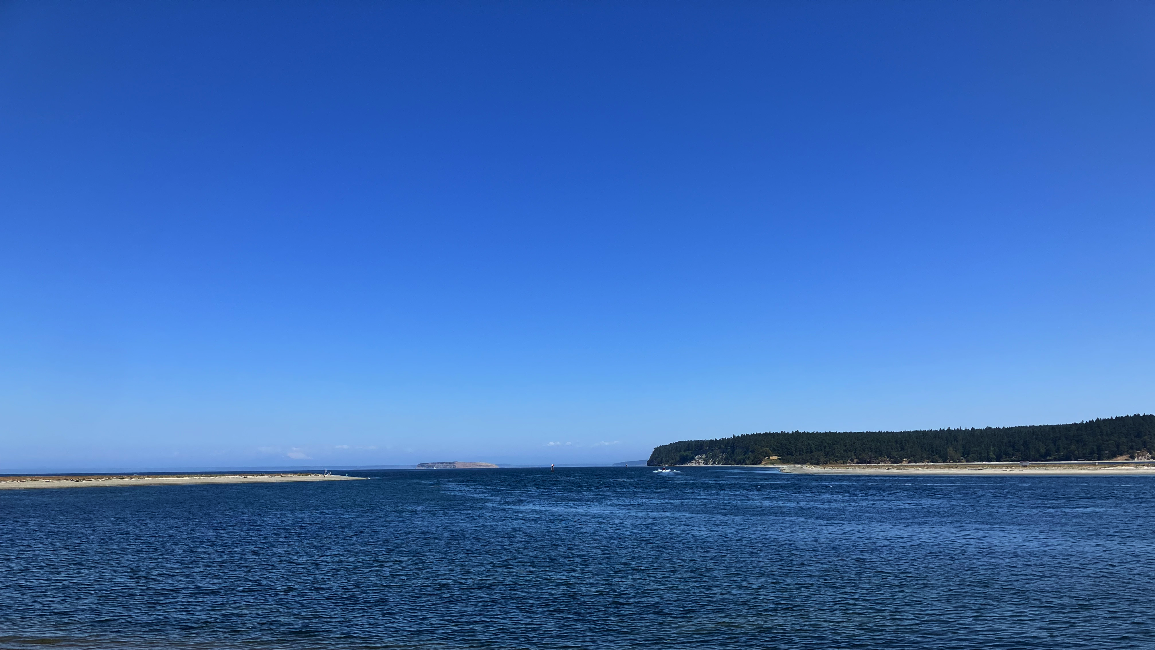
Seawater as a Strategic Resource team:
Jessica Cross (PI, Part 2)
Tristen Myers-Stewart
Lenaig Hemery
Noelani Boise
Jonathan Whiting
Special thanks:
Jonathan Whiting (The King of MCRLdata)
James McVey/Emma Cotter for AWS tips/tricks
Chris/Meg/Nick/Scott for scoping/support

Slide 17
The most important part
Quick demo
How can the sandbox help you?
What plots/stats would help your work?
Which parameters do you care about most?
What other content/capabilities do you want?
Please provide any feedback, especially how to make things clearer, simpler, or easier to find/use
pH and pCO2 (water and air)
ADCP – more info on horizontal profile (netCDF)
Chla and DO
Gap-fill pCO2 with modeling

Slide 18
pH and pCO2 (water and air)
ADCP – more info on horizontal profile (netCDF)
Chla and DO
Gap-fill pCO2 with modeling
Windspeed, tidal range, and temperature plots hosted on mcrldata
PAR – do we believe data? JW doesn’t trust them…
Acoustics would be most interesting to JH
Mhkdr as a potential repo for data publishing

Slide 19
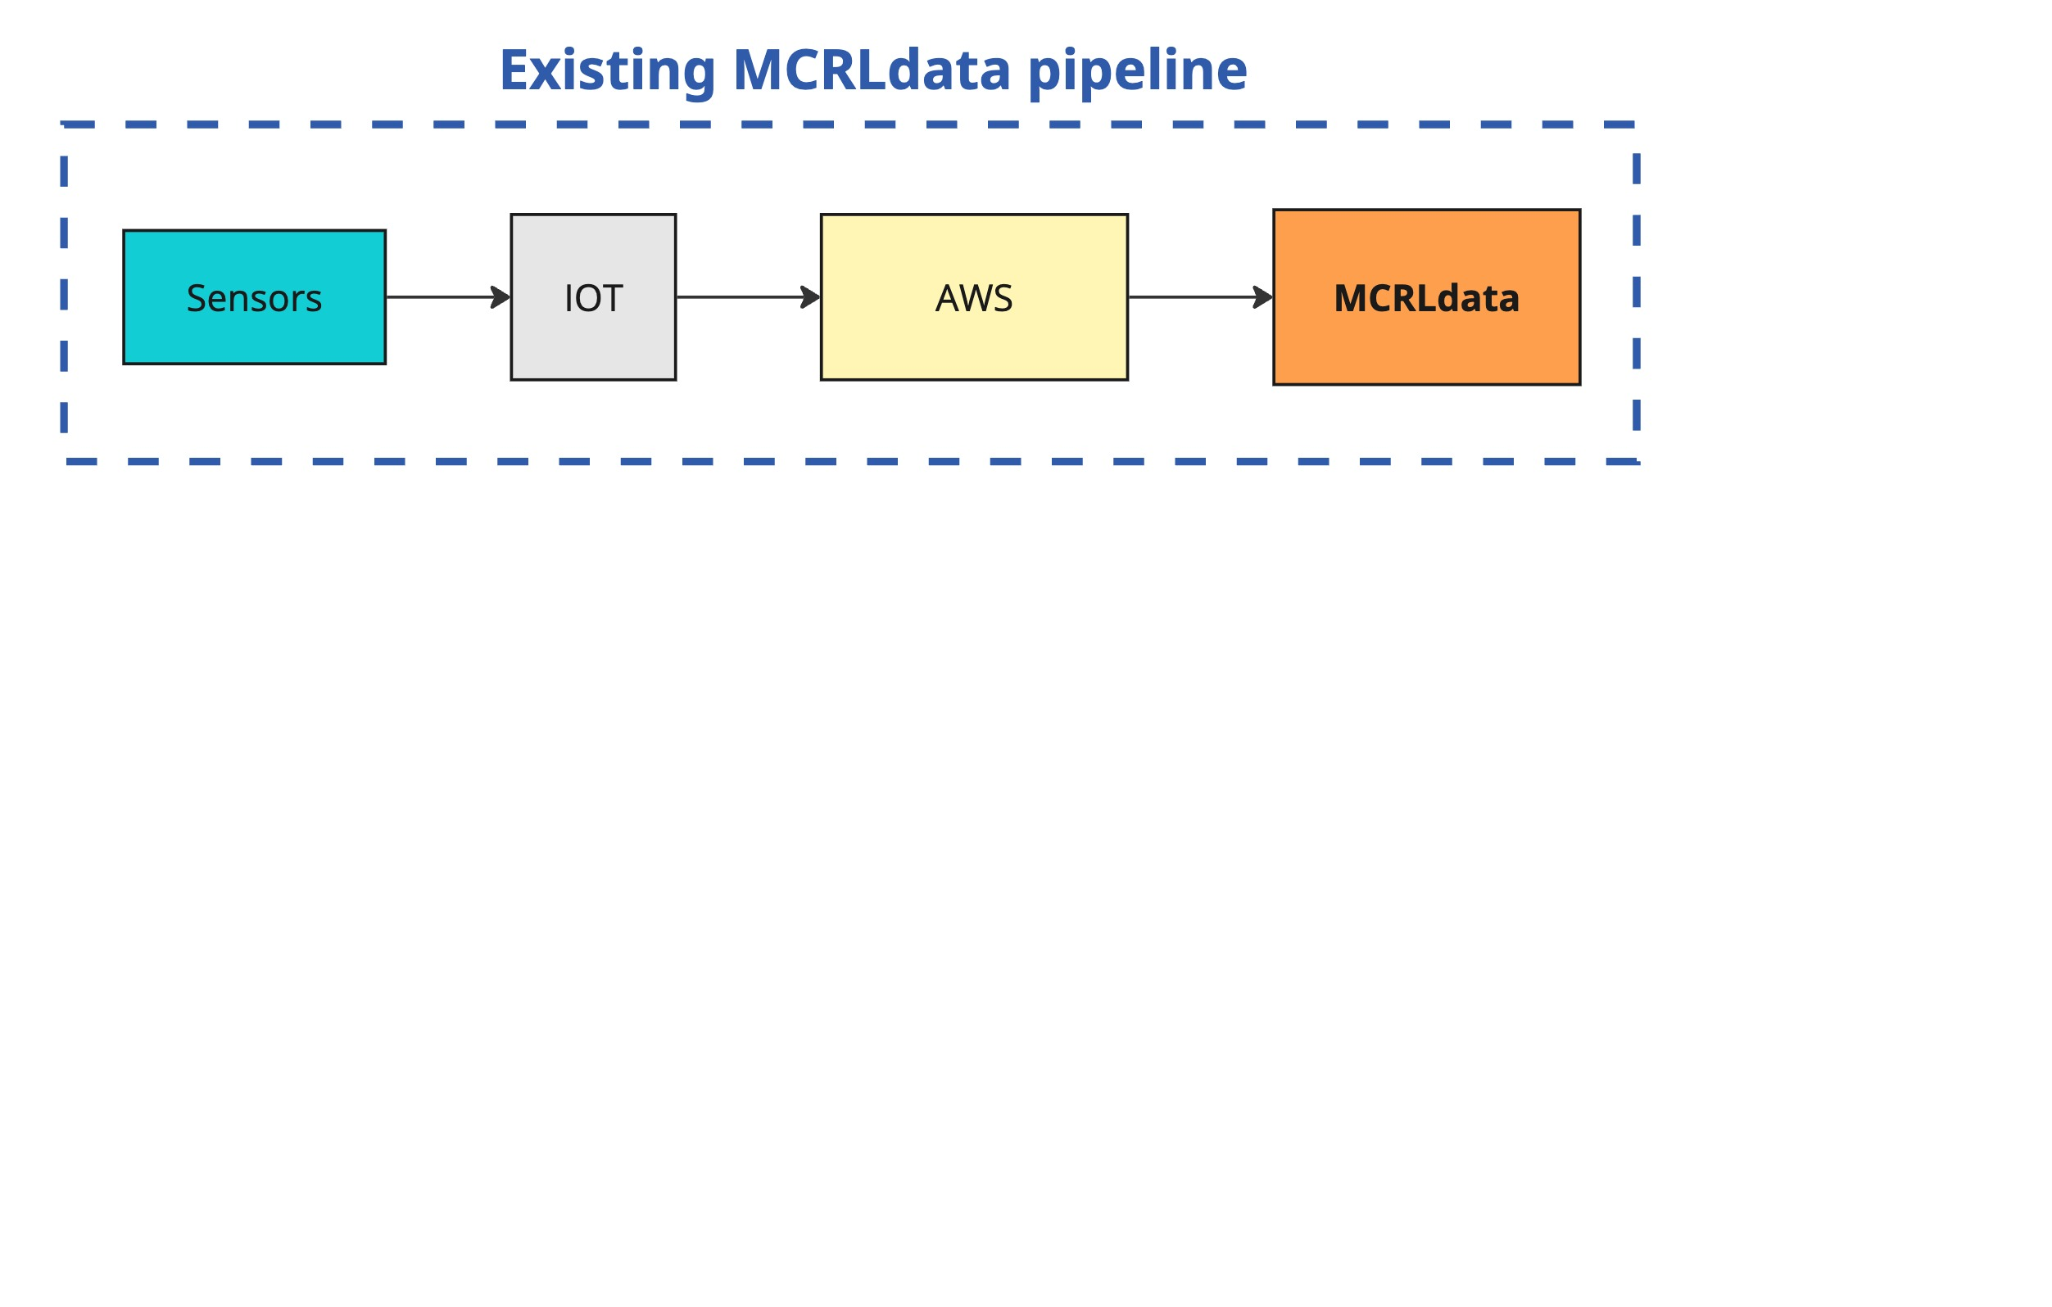
The MCRLdata sandbox
🤝
A sandbox enhancing and expanding MCRLdata capabilities
New methods to access data
A place for non-IOT data
Additional QC
Purpose-built visualizations
Tutorials
Play along at home! https://github.com/MCRLdata-Sandbox

Slide 20
What’s next?
Planned for FY25
Improve tutorials on Github use
Track read-from-raw Github-mediated interactions
Design a logo without nonsense
High-priority community feedback!
Wishlist
Expand R tutorials to Python

Slide 21
Seawater as a Strategic Resource
FY25 SMARTT LDRD funds
Two complementary parts -
Integrated Process Flows
Cross (PI), Myers-Stewart, Boise, Regier, Hemery
Optimizing the MCRL data pipeline (Sandbox and friends)
Regier (PI), Myers-Stewart, Hemery, Boise, Whiting, Cross
Task 1 – Improving data intake
Task 2 – Streamlining data upkeep
Task 3 – Opening data access
Task 4 – Codifying data training

